Slide 1
A Very Brief Intro to TensorFlow
Ben Sturm
May 10, 2018

Slide 2
What is TensorFlow?
TensorFlow is an open-source library for Deep Learning.
Developed by the Google Brain team and released in November 2015.
The current version of TenserFlow is 1.8.0
Notes:
The so-called "Google Brain" project began in 2011 as a part-time research collaboration between Google Fellow Jeff Dean, Google Researcher Greg Corrado, and Stanford University professor Andrew Ng.

Slide 3
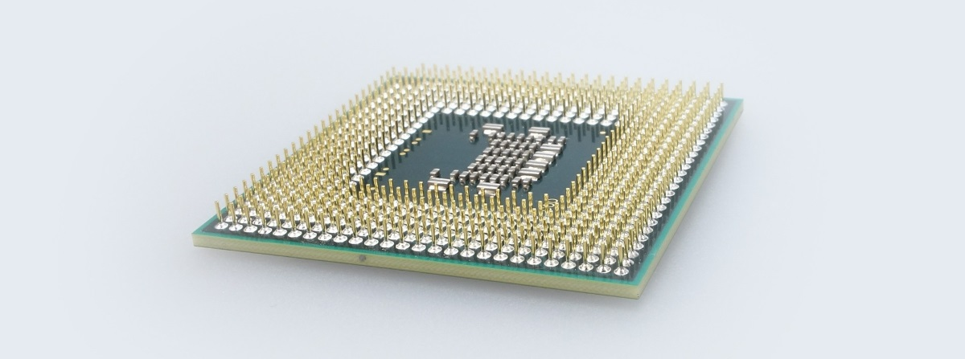
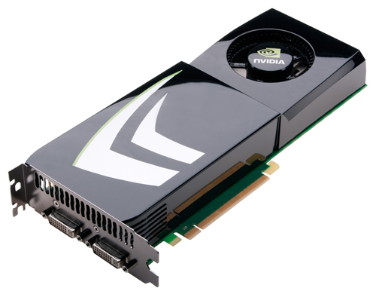
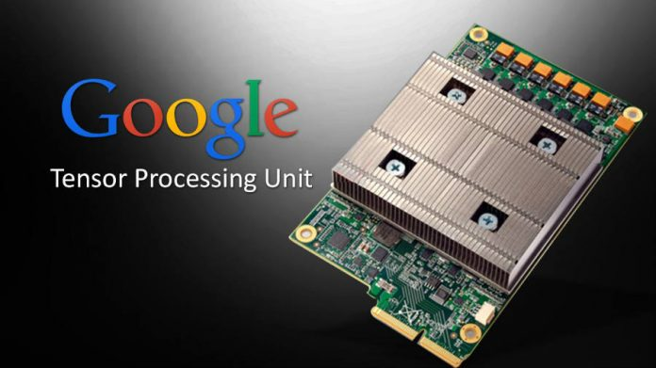
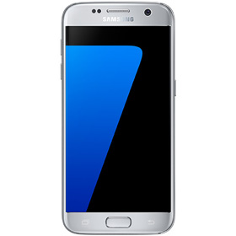
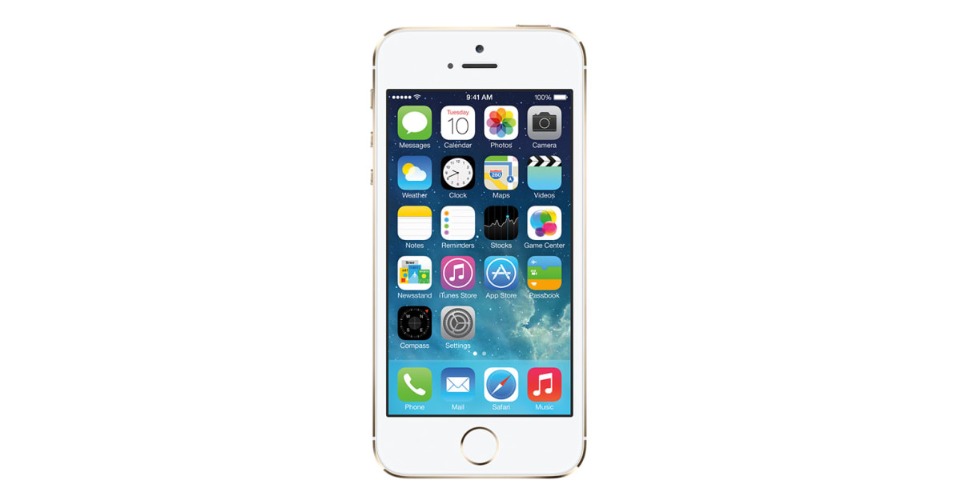
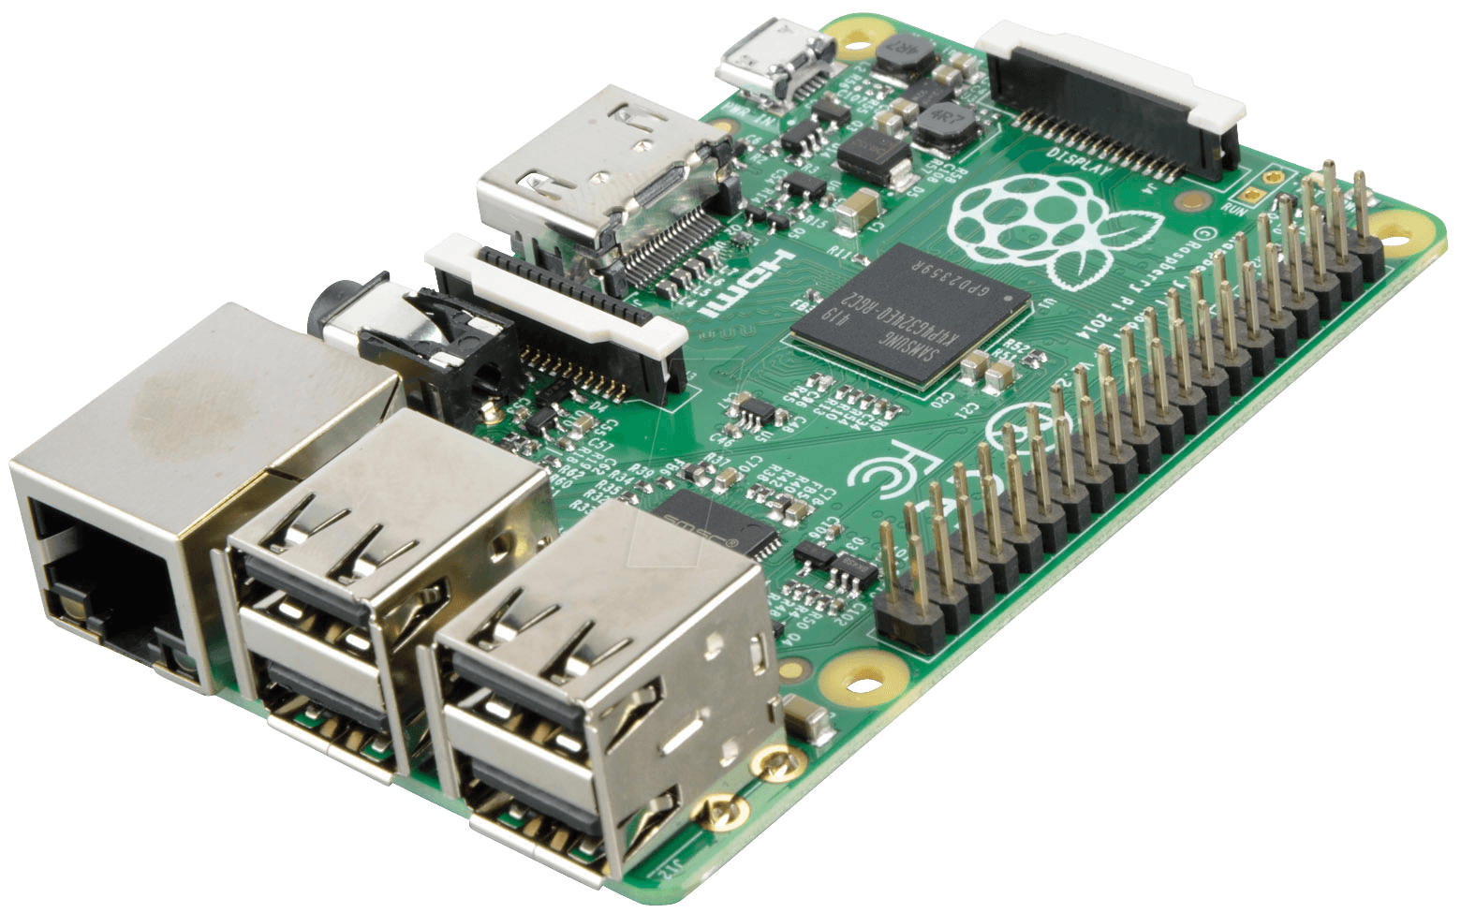
TensorFlow operates on a variety of platforms
CPU
GPU
TPU
Android
iOS
Raspberry Pi
Notes:
A tensor processing unit (TPU) is an AI accelerator application-specific integrated circuit (ASIC) developed by Google specifically for neural network machine learning
Values that flow along normal edges in the graph (from outputs to inputs) are tensors, arbitrary dimensionality arrays where the underlying element type is specified or inferred at graph-construction time.
Google has stated that they were used in the AlphaGo versus Lee Sedol series of man-machine Go games,^{[2]} as well as in the AlphaZero system which produced Chess, Shogi and Go playing programs from the game rules alone and went on to beat the leading programs in those games.[

Slide 4

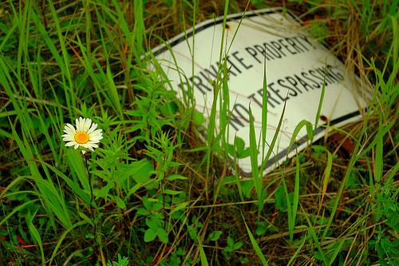
What can you do with it?
TensorFlow is really good at image classification, object detection, and speech recognition!
daisy (score=0.99988)
sunflowers (score=0.00010)
dandelion (score=0.00002)
roses (score=0.00000)
tulips (score=0.00000)
daisy (score=0.92591)
dandelion (score=0.07234)
roses (score=0.00121)
tulips (score=0.00050)
sunflowers (score=0.00004)
Notes:
I found a really great tutorial called TensorFlow for Poets which walked me through the steps of creating a flower classifier. For the tutorial, you download a set of flower photos which consist of about 3700 photos. This is your training data set. It took only about 2-3 minutes to train the model on my machine. Then, you can pass it new flower photos to see how well it does at classification. This tutorial used the MobilNet implementation of TensorFlow, which is optimized for mobile devices.

Slide 5
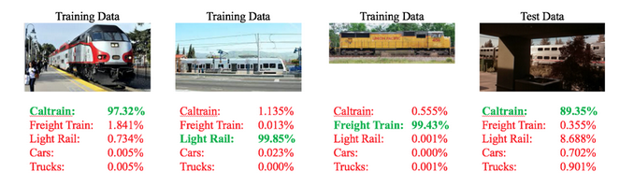
TensorFlow image recognition project on a RaspberryPi
IoT project which deployed TensorFlow on a RaspberryPi to classify trains and automobiles
Used to help improve the predictions of Caltrain arrival times
Hardware included a RaspberryPi2B, a PiCamera, and a USB Mircophone (Total cost = ~$130)

Slide 6

Train Tensorflow video
Notes:
LiveSlide Site
https://www.youtube.com/watch?v=n0lCPXzaxTg

Slide 7
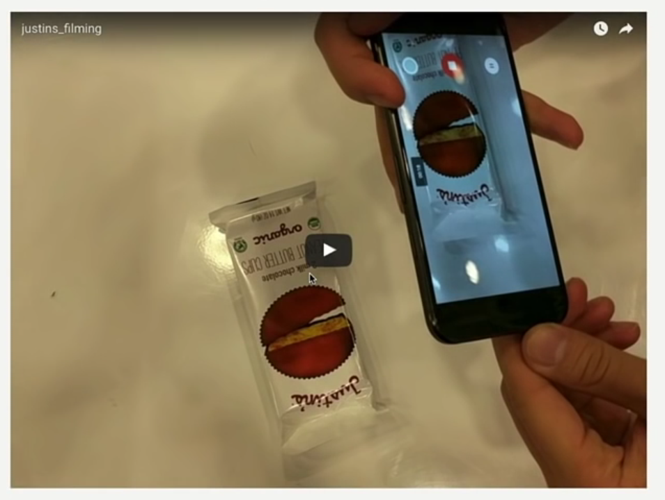
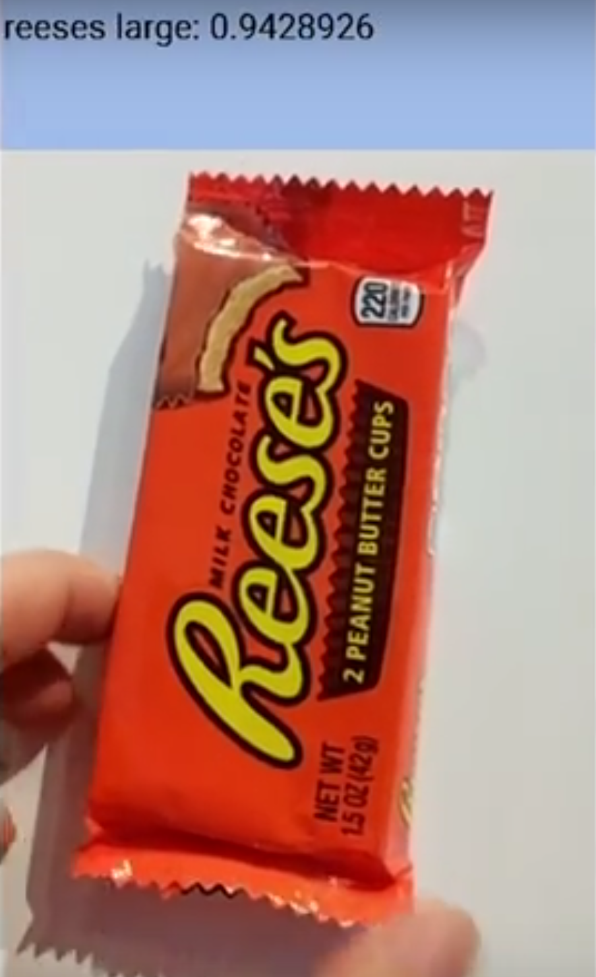
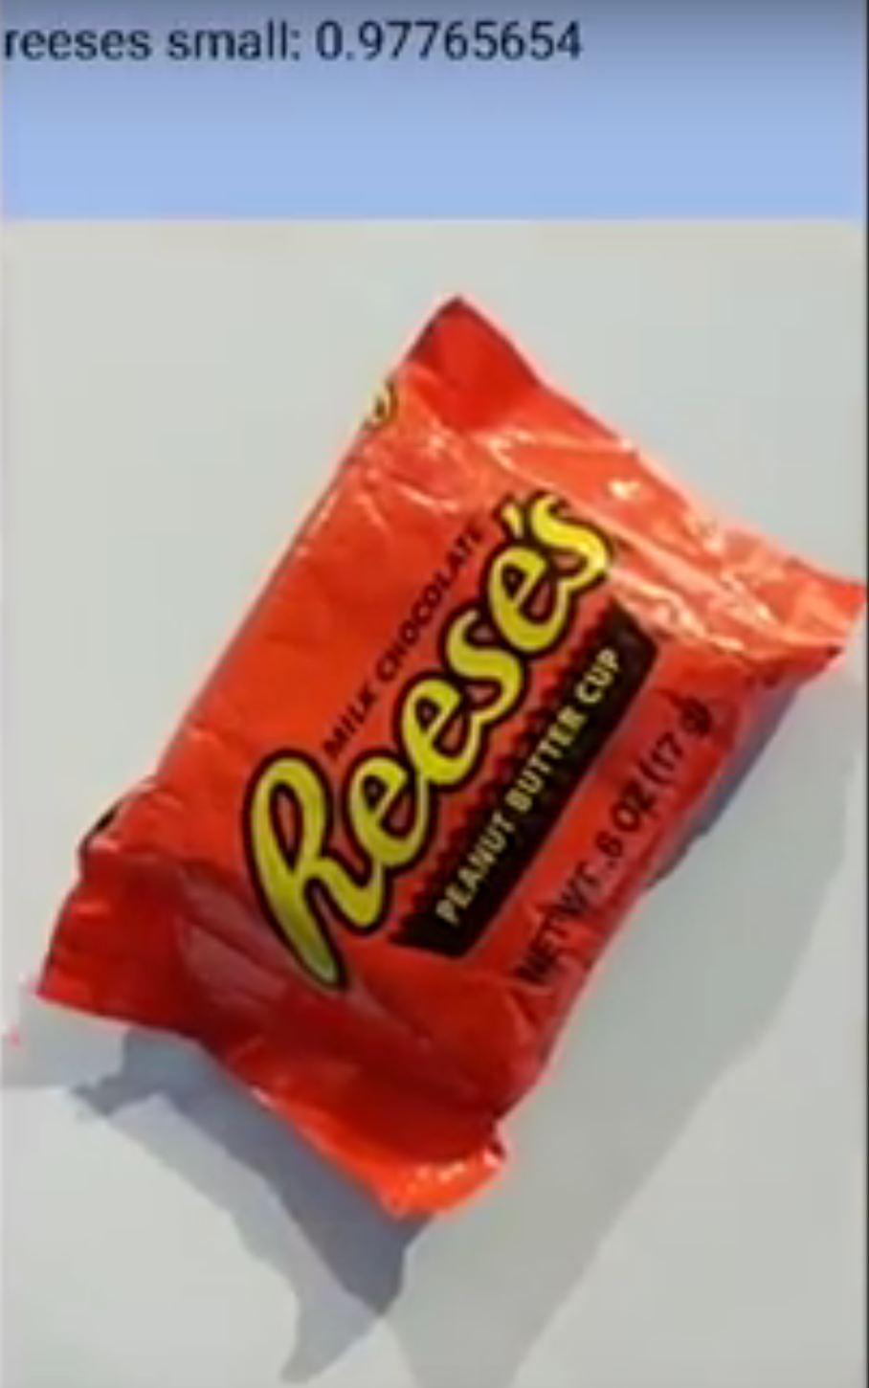
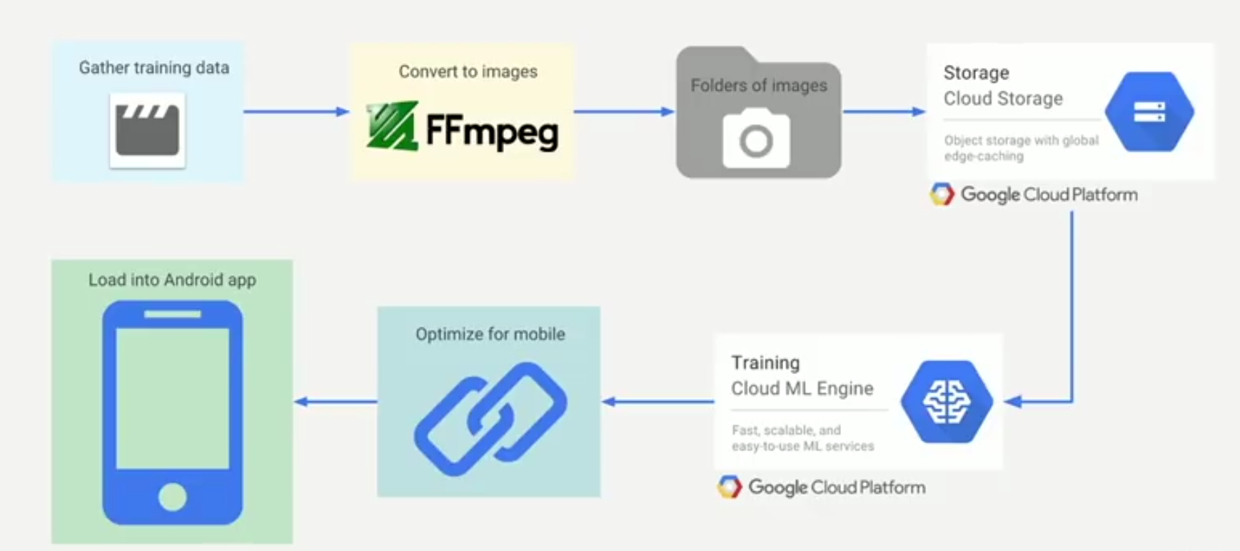
TensorFlow for Android application
Video data used for training
Android app could classify
different candy in realtime

Slide 8
Some useful resources to learn more
TensorFlow for Poets, Pete Warden
Image recognition on a RaspberryPi, Matthew Rubashkin
Candy Sorter Demo, Yufeng Guo

